Slide 1
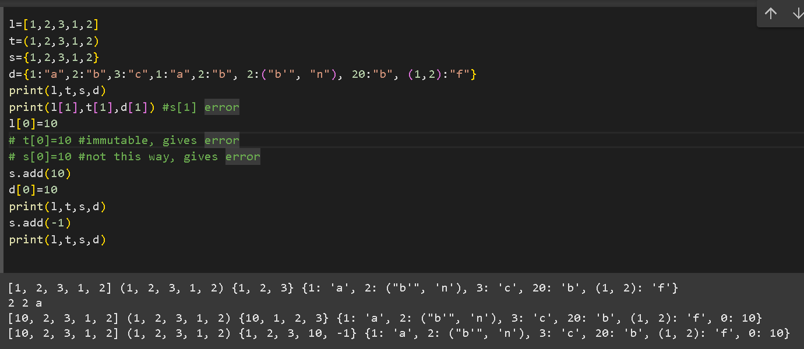
Python Collections

Slide 2
What is Not a “Collection”?
Most of our variables have one value in them - when we put a new value in the variable, the old value is overwritten
x = 2
print(x)---→ 2
x = 4
print(x)---→ 4
But what if you need to store a long list of information?
Say, for example, the names of the months of the year.
4

Slide 3
What is a “Collection”?
A collection allows us to put many values in a single “variable”.
There are four collection data types in the Python programming language:
List is a collection which is ordered and changeable/mutable. Allows duplicate members. Example: a=[1,2,2,”3”]; ok: a[0], a[0]=1, a=[2,2,3] =>out=>[2,2,3]
Tuple is a collection which is ordered and unchangeable/immuatble. Allows duplicate members. a=(1,2,2,3). error: a[0]=1
Set is a collection which is unordered and unindexed and mutable. No duplicate members. a={1,2,3}
Dictionary is a collection which is *unordered, changeable/mutable and indexed. No duplicate members. a={key : value} i.e. a={ “ID” : 1,
“Name” : “Aysha”,
“Email” : “abc@gmail.com” }

Slide 4
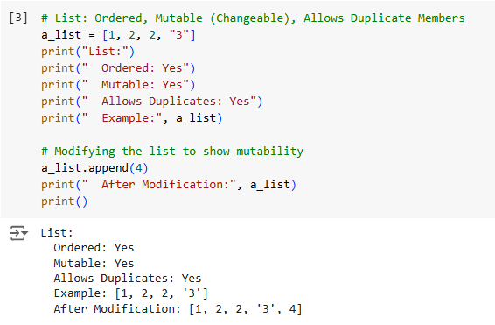
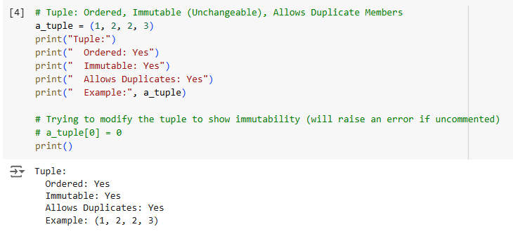

Slide 5
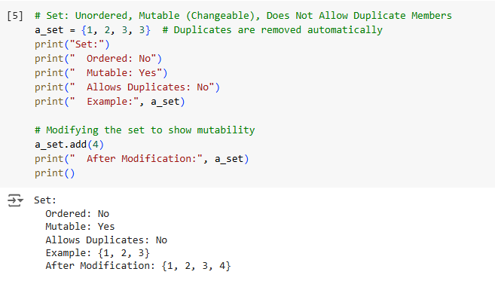
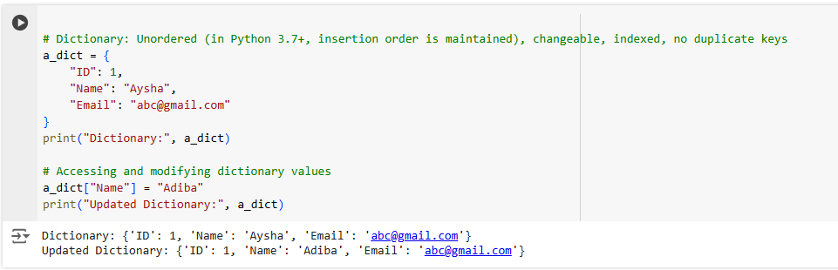

Slide 6
List[]
Lists are what they seem - a list of values.
Lists are modifiable.
We use lists, when we want to change the values of things if we need to.
Example: A List of all steps necessary to cook a chicken, because Lists support sequential access and we can access the steps in order.
The list elements can be anything and each list element can have a completely different type. This is not allowed in arrays.
Therefore, when we talk about python arrays, we usually mean python Lists.
However, python does provide Numpy Arrays which are a grid of values used in Data Science.

Slide 7
Tuple()
Tuples are just like lists, but you can't change their values.
So, use a tuple when you know what information goes in the container that it is.
For example, the names of the months of the year.

Slide 8
Set{}
Sets are another standard Python data type that also store values but you can't change their values. The major difference is that sets, unlike lists or tuples, cannot have multiple occurrences of the same element and store unordered values.
You can use a Set to store passport numbers, because a Set enforces uniqueness among its elements. Passport numbers are always unique and two people can't have the same one.

Slide 9
Dictionaries{key:value}
Dictionaries are similar to what their name suggests - a dictionary.
In a dictionary, you have an 'index' of words, and for each of them a definition.
In python, the word is called a 'key', and the definition a 'value'. You can add, remove, and modify the values in dictionaries.
Example: telephone book.
Restrictions on Dictionary Keys
Almost any type of value can be used as a dictionary key in Python, e.g. integer, float, and Boolean objects just the key should be unique just like you cannot find out the correct information if you have two persons with the exact same name. There are a couple restrictions that dictionary keys must abide by.
First, a given key can appear in a dictionary only once. Duplicate keys are not allowed.
Secondly, a dictionary key must be of a type that is immutable. A tuple can also be a dictionary key, because tuples are immutable. Neither a list nor another dictionary can serve as a dictionary key, because lists and dictionaries are mutable.

Slide 10
There are a few things we typically want to do with list, tuple, set and dictionary :
retrieve (or set) an item at a specific position via indexing.
check for membership (e.g. does the list/tuple, set/dictionary: contain the number 5?).
Concatenate/join two list/tuple/set/dictionary together.
get the length of the list/tuple/set/dictionary.
add an item to the list/tuple/set/dictionary.
remove an item from the list/tuple/set/dictionary.

Slide 11
What is the difference between a list, tuple, set and dictionary?
Mutable/immutable : i. list ii. tuple iii. set iv. dictionary
How to access a single element/a range of elements from a list/tuple/set/dictionary?
How to add elements to list/tuple/set/dictionary?
How to delete elements from list/tuple/set/dictionary?

Slide 12
Python list Methods: https://www.w3schools.com/python/python_ref_list.asp
Python Dictionary Methods: https://www.w3schools.com/python/python_ref_dictionary.asp
Python Tuple Methods: https://www.w3schools.com/python/python_ref_tuple.asp
Python Set Methods: https://www.w3schools.com/python/python_ref_set.asp

Slide 13
Assignment
1. List Questions
Retrieve an item at a specific position via indexing: How would you retrieve the 5th element from my_list = [10, 20, 30, 40, 50, 60, 70, 80, 90, 100]?
Check for membership: How can you check if the number 25 is present in my_list = [10, 20, 30, 40, 50, 60, 70, 80, 90, 100]?
Concatenate/join lists: How would you merge [1, 2, 3, 4, 5] and [6, 7, 8, 9, 10] into one list?
Get the length of a list: How can you find the number of elements in my_list = [15, 25, 35, 45, 55, 65, 75, 85, 95, 105]?
Add an item to the list: How would you append 110 to my_list = [10, 20, 30, 40, 50, 60, 70, 80, 90, 100]?
Remove an item from the list: How can you remove 50 from my_list = [10, 20, 30, 40, 50, 60, 70, 80, 90, 100]?
Sort a list: How would you sort my_list = [50, 40, 30, 20, 10, 60, 70, 80, 90, 100] in ascending order?
Slice a list: How would you retrieve elements from index 3 to 8 in my_list = [1, 2, 3, 4, 5, 6, 7, 8, 9, 10]?
Calculate sum and average of list elements: How would you calculate the sum and mean of my_list = [12, 14, 16, 18, 20, 22, 24, 26, 28, 30]?
List comprehension for transformations: How can you create a new list containing cubes of all numbers in my_list = [1, 2, 3, 4, 5, 6, 7, 8, 9, 10]?
Flatten nested lists: How would you convert nested_list = [[1, 2], [3, 4]] into [1, 2, 3, 4]?

Slide 14
#1
my_list = [10, 20, 30, 40, 50, 60, 70, 80, 90, 100]
my_list[4]
#2
my_list = [10, 20, 30, 40, 50, 60, 70, 80, 90, 100]
25 in my_list
#3
a=[1, 2, 3, 4, 5]
b=[6, 7, 8, 9, 10]
c=a+b
c
#4
my_list = [15, 25, 35, 45, 55, 65, 75, 85, 95, 105]
len(my_list)
#5
my_list = [10, 20, 30, 40, 50, 60, 70, 80, 90, 100]
my_list.append(110)
my_list
#6
my_list = [10, 20, 30, 40, 50, 60, 70, 80, 90, 100]
my_list.remove(50)
my_list
#7
my_list = [50, 40, 30, 20, 10, 60, 70, 80, 90, 100]
my_list.sort()
my_list
#8
my_list = [1, 2, 3, 4, 5, 6, 7, 8, 9, 10]
my_list[3:9]
#9
my_list = [12, 14, 16, 18, 20, 22, 24, 26, 28, 30]
sum_ = sum(my_list)
n = len(my_list)
avg = sum_/n
print("sum=", sum_, "& average=", avg)
#10
my_list = [1, 2, 3, 4, 5, 6, 7, 8, 9, 10]
cubes = [i**3 for i in my_list]
cubes
#11
nested_list = [[1, 2], [3, 4]]
single_list = []
for i in range(2):
for j in range(2):
single_list.append(nested_list[i][j])
single_list

Slide 15
Assignment
2. Tuple Questions
Retrieve an item at a specific position via indexing: How can you access the 1st element of my_tuple = (10, 20, 30)?
Check for membership: How would you check if the number 15 exists in my_tuple = (5, 10, 15, 20)?
Concatenate/join tuples: How can you combine (1, 2) and (3, 4) into one tuple?
Get the length of a tuple: How can you find the number of elements in my_tuple = (100, 200, 300)?
Convert tuple to list and back: How would you modify (1, 2, 3) by first converting it to a list, adding 4, and converting it back to a tuple?
Tuple unpacking: How can you assign elements of (1, 2, 3) to variables a, b, and c?
Use tuple as a dictionary key: How can you use (1, 2) as a key in a dictionary?

Slide 16
#1
my_tuple = (10, 20, 30)
my_tuple[0]
#2
my_tuple = (5, 10, 15, 20)
15 in my_tuple
#3
a=(1, 2)
b=(3, 4)
a+b
#4
my_tuple = (100, 200, 300)
len(my_tuple)
#5
my_tuple=(1, 2, 3)
my_list=list(my_tuple)
my_list=(i+4 for i in my_list)
tuple(my_list)
#6
a,b,c= (1, 2, 3)
print(a,b,c)
#7
x={(1,2):"a"}
x

Slide 17
Assignment
3. Set Questions
Check for membership: How can you check if 8 exists in my_set = {1, 2, 3, 4, 5, 6, 7, 8, 9, 10}?
Concatenate/join sets: How would you combine set1 = {1, 2, 3, 4, 5} and set2 = {6, 7, 8, 9, 10}?
Get the length of a set: How can you find the number of elements in my_set = {11, 12, 13, 14, 15, 16, 17, 18, 19, 20}?
Add an item to a set: How can you add 25 to my_set = {10, 20, 30, 40, 50, 60, 70, 80, 90, 100}?
Remove an item from a set: How would you remove 30 from my_set = {10, 20, 30, 40, 50, 60, 70, 80, 90, 100}?
Union, intersection, and difference of sets: How can you find the union, intersection, and difference of A = {1, 2, 3, 4, 5} and B = {4, 5, 6, 7, 8}?

Slide 18
#1
my_set = {1, 2, 3, 4, 5, 6, 7, 8, 9, 10}
8 in my_set
#2
set1 = {1, 2, 3, 4, 5}
set2 = {6, 7, 8, 9, 10}
set.union(set1,set2)
#3
my_set = {11, 12, 13, 14, 15, 16, 17, 18, 19, 20}
len(my_set)
#4
my_set = {10, 20, 30, 40, 50, 60, 70, 80, 90, 100}
my_set.add(25)
my_set
#5
my_set = {10, 20, 30, 40, 50, 60, 70, 80, 90, 100}
my_set.remove(30)
my_set
#6
A = {1, 2, 3, 4, 5}
B = {4, 5, 6, 7, 8}
print(A.union(B))
print(A.intersection(B))
print(A.difference(B))

Slide 19
Assignment
4. Dictionary Questions
Retrieve a value by key: How can you get the value of "key5" in my_dict = {"key1": 1, "key2": 2, "key3": 3, "key4": 4, "key5": 5, "key6": 6, "key7": 7, "key8": 8, "key9": 9, "key10": 10}?
Check for membership: How would you check if "key12" exists in my_dict = {"key1": 10, "key2": 20, "key3": 30, "key4": 40, "key5": 50, "key6": 60, "key7": 70, "key8": 80, "key9": 90, "key10": 100}?
Add an item to a dictionary: How can you add {"key11": 110} to my_dict = {"key1": 10, "key2": 20, "key3": 30, "key4": 40, "key5": 50, "key6": 60, "key7": 70, "key8": 80, "key9": 90, "key10": 100}?
Update a value in a dictionary: How can you change the value of "key5" from 50 to 500 in my_dict = {"key1": 10, "key2": 20, "key3": 30, "key4": 40, "key5": 50, "key6": 60, "key7": 70, "key8": 80, "key9": 90, "key10": 100}?
Iterate through dictionary items: How can you iterate over keys and values in my_dict = {"key1": "A", "key2": "B", "key3": "C", "key4": "D", "key5": "E", "key6": "F", "key7": "G", "key8": "H", "key9": "I", "key10": "J"}?

Slide 20
#1
my_dict = {"key1": 1, "key2": 2, "key3": 3, "key4": 4, "key5": 5, "key6": 6, "key7": 7, "key8": 8, "key9": 9, "key10": 10}
my_dict["key5"]
#2
my_dict = {"key1": 10, "key2": 20, "key3": 30, "key4": 40, "key5": 50, "key6": 60, "key7": 70, "key8": 80, "key9": 90, "key10": 100}
"key12" in my_dict
#3
my_dict = {"key1": 10, "key2": 20, "key3": 30, "key4": 40, "key5": 50, "key6": 60, "key7": 70, "key8": 80, "key9": 90, "key10": 100}
my_dict.update({"key11": 110})
my_dict
#4
my_dict = {"key1": 10, "key2": 20, "key3": 30, "key4": 40, "key5": 50, "key6": 60, "key7": 70, "key8": 80, "key9": 90, "key10": 100}
my_dict.update({"key5": 500})
my_dict
#5
my_dict = {"key1": "A", "key2": "B", "key3": "C", "key4": "D", "key5": "E", "key6": "F", "key7": "G", "key8": "H", "key9": "I", "key10": "J"}
for k,v in my_dict.items():
print("key:",k," value:", v)

